Slide 1
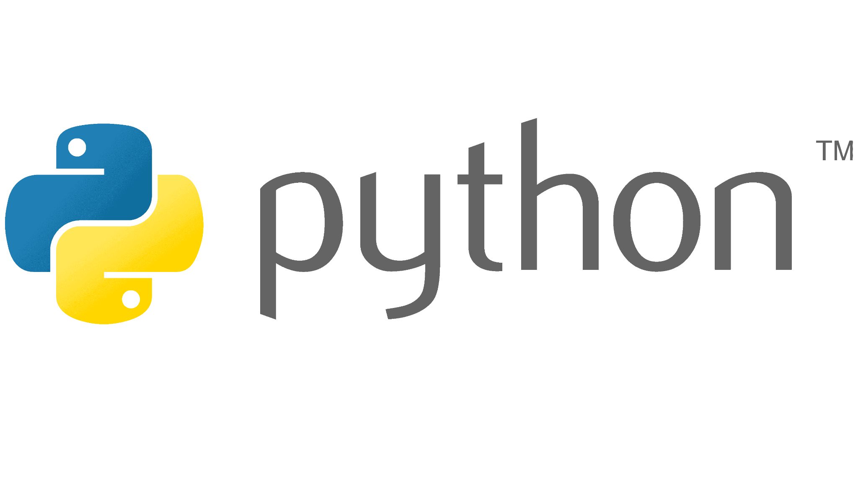


Slide 2

Last lecture reminder
We learned about:
What is Python and what we can build by using it
Client side Vs Server side and the Client - Server Model
Python features ( Interpreter, dynamic typing, exc… )
Declaring on variables in Python
Operators in Python ( Arithmetic operators, Relational operators, exc … )
True / False statements by using conditional operators ( && , || , ! )

Slide 3
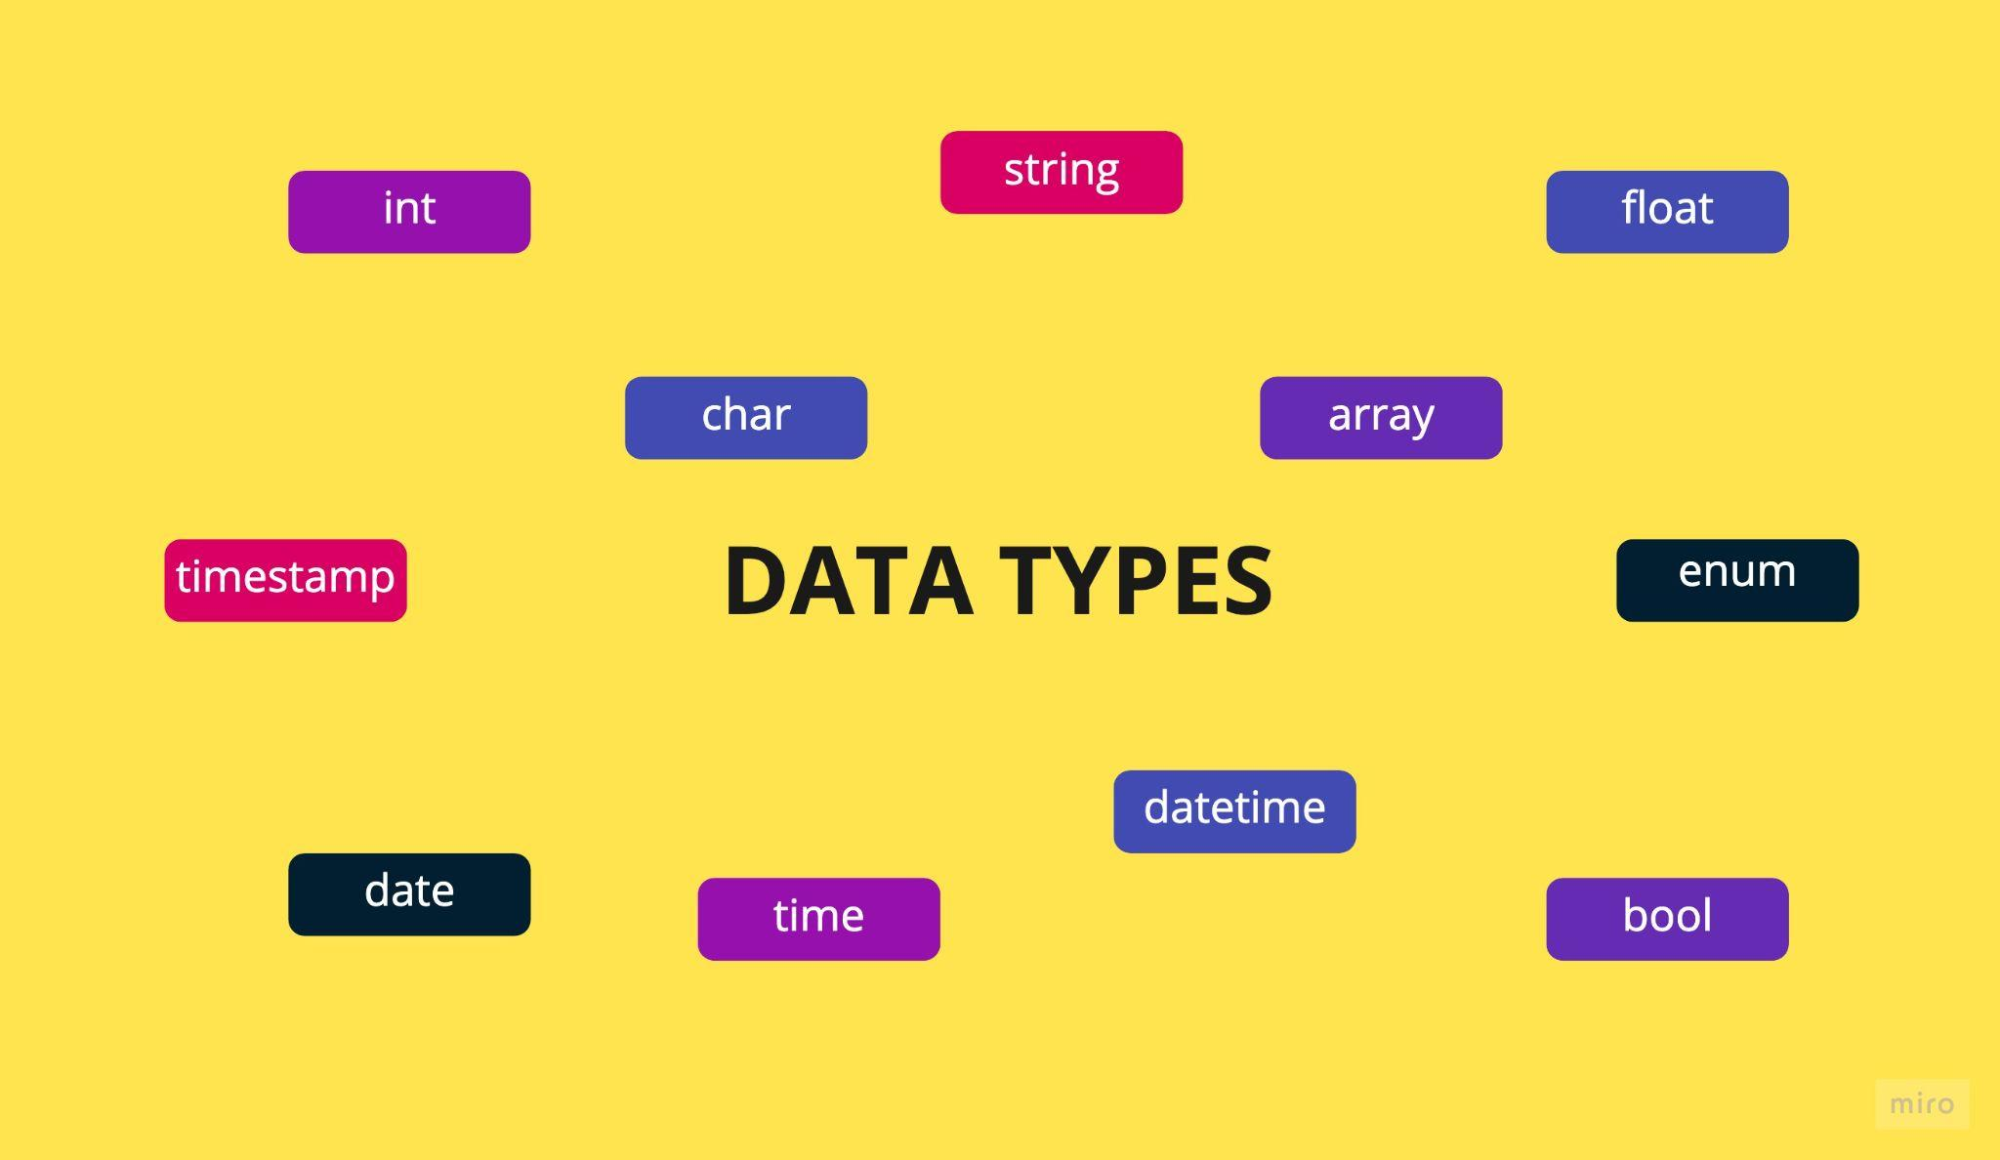
Data Types in Python

Slide 4
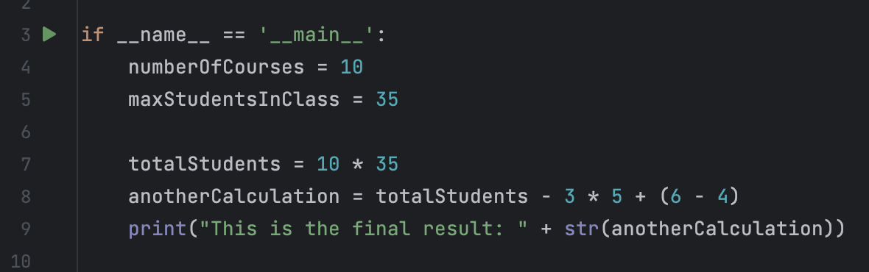

Python Data Types
Numbers - Use for calculations and perform mathematical actions

Slide 5
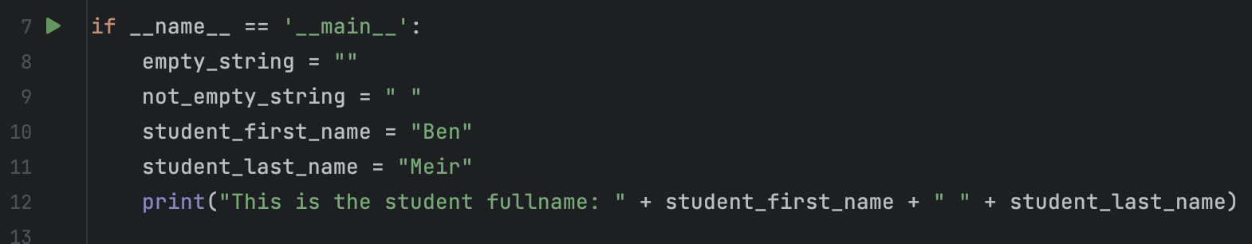

Python Data Types
Strings - Use to represent text, strings are combinations of chars. In Python everything that is under double quotes (“”) is define as a single string. We can concatenate strings by using the + operator

Slide 6
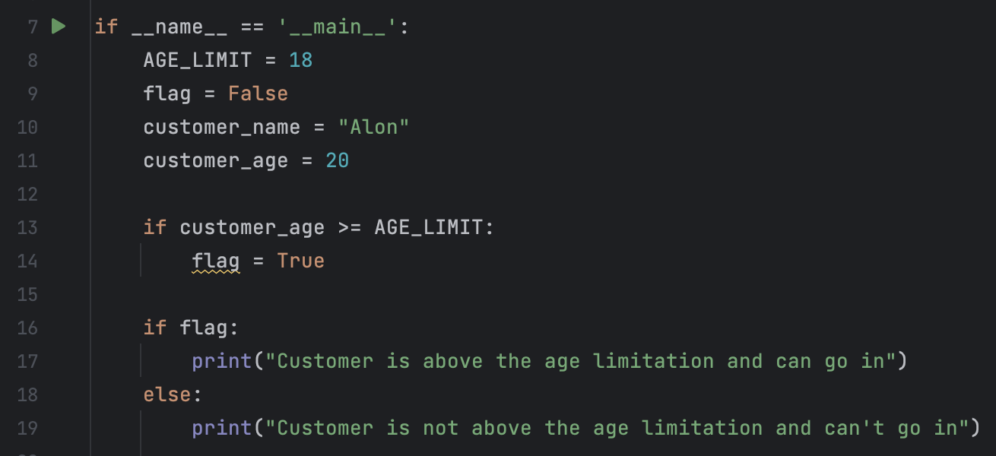
Python Data Types
Boolean - This is a special variable that can hold only two values: “True” or “False” We will use boolean data type when we want to create a “flag” that according to its value we will do an action

Slide 7
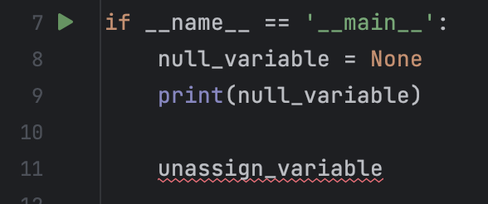

Python Data Types
None - none is a special data type that responsible to represent empty. when a variable is holding an empty value, Python will represent this value as “None”. In other languages it can be referred as “null”. Unlike other programing languages Python not allow to create variable without assign value to it.
In Python this will result an error

Slide 8
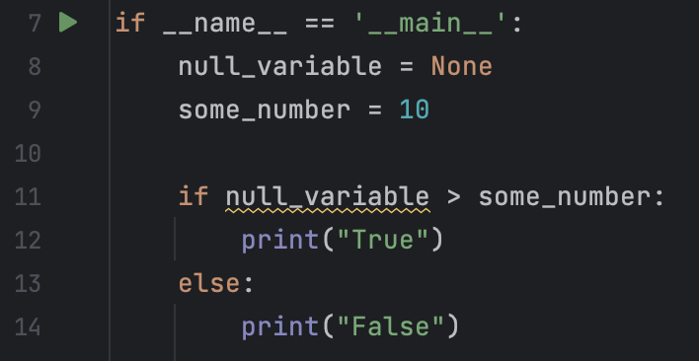
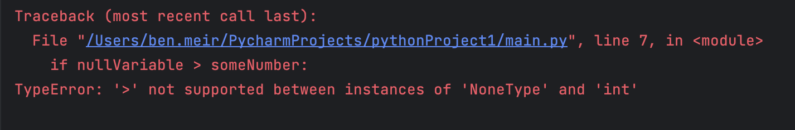
Python Data Types
None - When we will try to do programming actions on None variables in some cases they will result an run time error
For example:

Slide 9
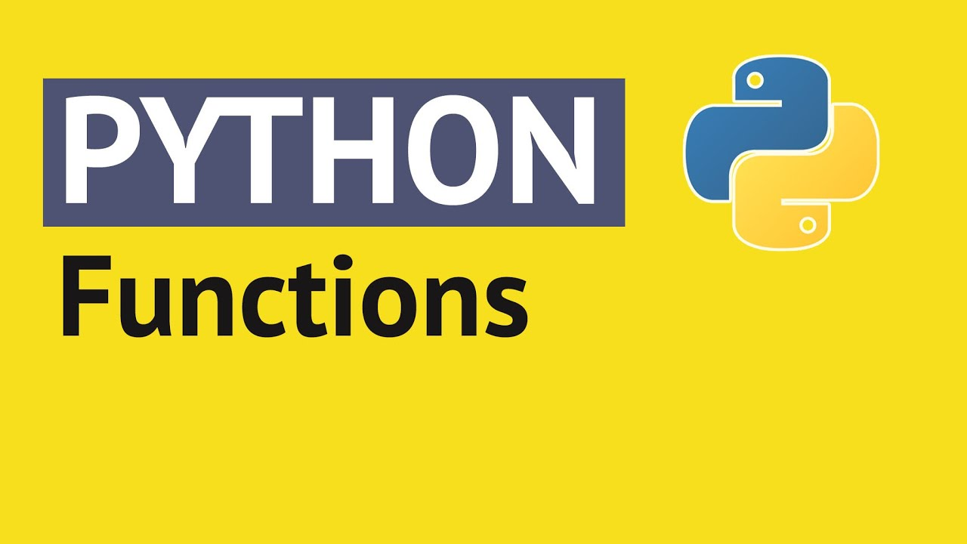

Slide 10
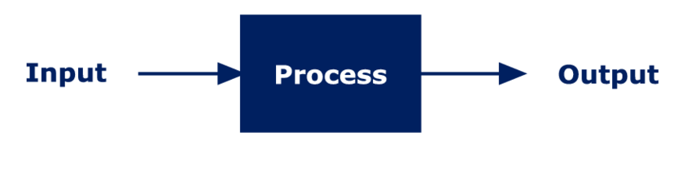
What is a programming function?
Programming functions in general giving you the ability to define code that your program can execute any time and anywhere in your code
By using function we can:
Use the same block of code everywhere we want without rewrite it
Run code only when something that we want happen (like pressing a button)
Keep our code short and clean
Better explain our code to other developers
Functions in general represent this flow:

Slide 11
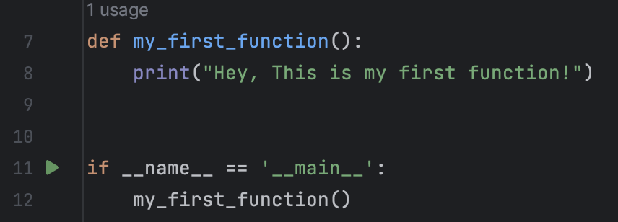

Functions in Python
By using the def Python keyword we are declaring on a new function
In order to create a function in Python we have to use the def keyword
After declaring a function we need to give it a name
Same as with variables, Python allow us to choose any name you want
We should choose names to our functions that represent the purpose of the function For example: validateStudentAge() , getName(), exc...

Slide 12
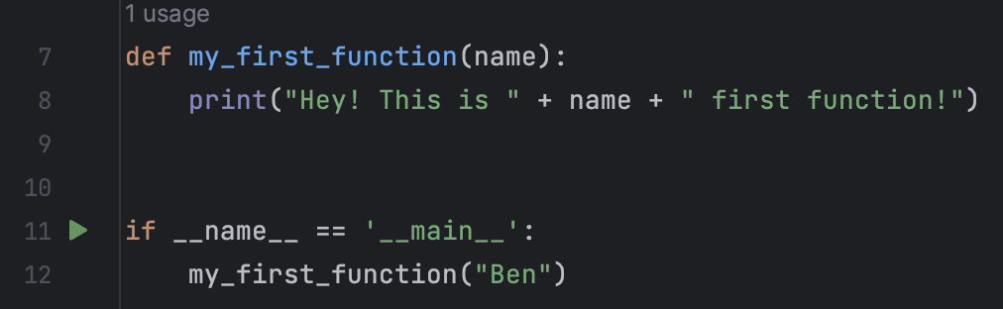
Functions in Python
After we determined the name of our function we need to choose the input our function should get in order to produce the output, We call it Parameters.
We should put the function parameters between - ()
We can pass as much parameters as we want to a single functions - (parameter1, parameter2, parameter3, …)
If our function has no parameters we will use empty ()
Without providing all the parameters the function could not be executed and we will get an error

Slide 13
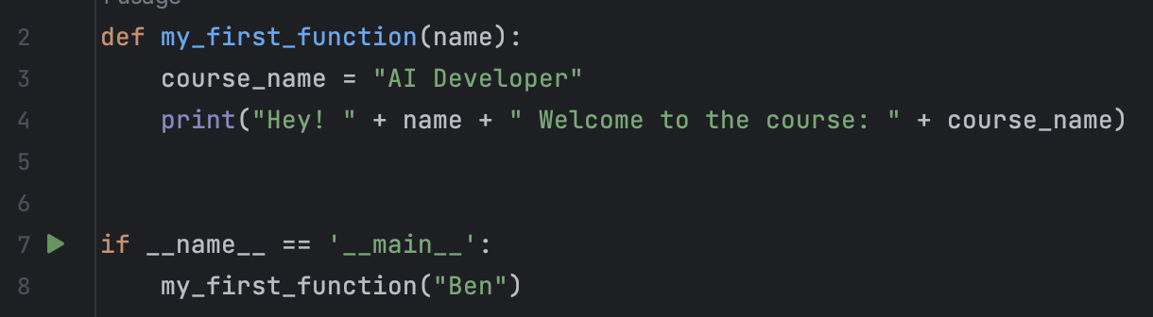
Functions in Python
The “process” part of the function is what we put below the : Everything blow the : sign and with 1 addentation to the right is been called function scope or function block
Every code inside the function scope is been executed line by line when we call it, everytime we call it
Inside the function scope we can use all the parameters this function got by calling their names
In addition, We can create new variables that will only be exists inside the function scope

Slide 14
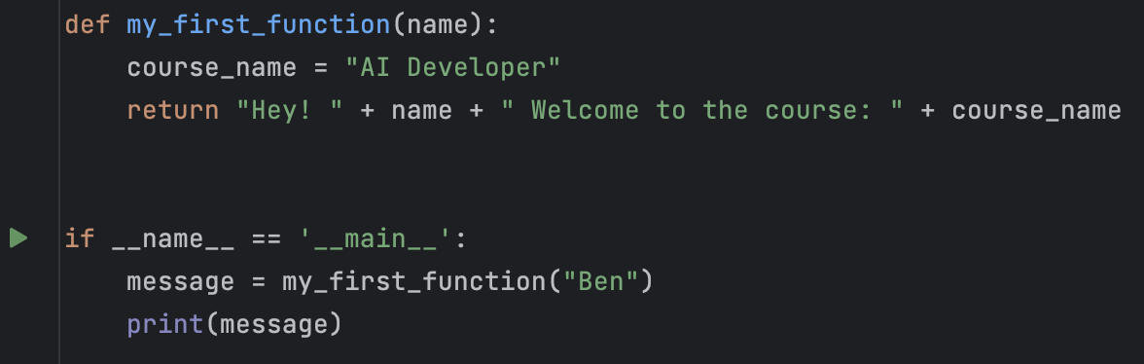
Functions in Python
The “output” part of the function is what we return when the function finish to execute all the code inside the function scope
By using the return keyword we determine what is the output of our function
Return should only been put at the end of the function
The return keyword end the function execution and “close” it
We can put more than one return inside a function but its best practice to avoid that and use just one return
It's not mandatory to return a value, so we can create functions that are not returning anything and doesn’t use the return keyword

Slide 15
Functions in Python
How to call Python function?
Make sure that the function you want to call is already been created
In the code outside the function scope write the function name and put () after it
If the function required parameters put them inside the () and pass them by using , between them
If the function return a value you can save it to a variable or use it in any way you want to

Slide 16
Class Exercise - Functions

Slide 17

Class Exercise - Functions
Instructions:
Open your Pycharm project and create new Python package called “Python functions” Inside this package create new file called “main.py” and create a main run command.
Your mission is to create a basic calculator with all 4 basic arithmetic actions Your calculator should only work with two numbers at each time Your calculator should implement the following:
Add function ( 8 + 4 = 12 )
Reduction function ( 8 - 4 = 4 )
Multiple function ( 8 * 4 = 32 )
Division function ( 8 / 4 = 2 )
You should test your calculator by calling each function and print the output to the console

Slide 18
Class Exercise - Functions Solution

